Slide 1

Results of the Survey of Employment in South Moravia
Labour Office Czech Republic
Regional Branch in Brno

Slide 2
Basic information
Area: Region of South Moravia
Cooperation with South Moravian Regional Authority
Determining date: 31.12.2011
Implementation from 23.1. to 30.3.2012
3 744 employers addressed, return of the survey – 79,6 % (2 981)

Slide 3
Outcomes of the survey
Total number of employees in South Moravia: 220 578
Share of women: 49,1 %
Share of foreigners: 3,2 %
Share of par-time jobs: 8,1 %

Slide 4
Regional structure of the questionnaire survey
region | Number of respondents | Share in total(%)
Blansko | 273 | 9,1
the city of Brno | 1354 | 45,3
the outskirts of Brno | 386 | 12,9
Břeclav | 240 | 8,0
Hodonín | 303 | 10,1
Vyškov | 218 | 7,3
Znojmo | 214 | 7,2

Slide 5
Sector structure
sector | Number of employees | Share in total employment (%)
I. sector (agriculture and forestry) | 5626 | 2,6
II. Sector (industry and civil engineering) | 84017 | 38,1
III. Sector (other sectors of the national economy) | 130935 | 59,3
NE in total | 220578 | 100,0

Slide 6
Representativeness of the survey
Sectors (CZ-NACE) | Number of the employed |  | Questionnaire survey/total
 | In total | Questionnaire survey
I. sector | 15,5 | 5,7 | 36,8
II. sector | 191,0 | 84,0 | 44,0
industry | 145,0 | 74,4 | 51,3
construction industry | 46,1 | 9,6 | 20,8
III. sector | 322,8 | 130,9 | 40,6
Total | 527,1 | 220,6 | 41,9

Slide 7
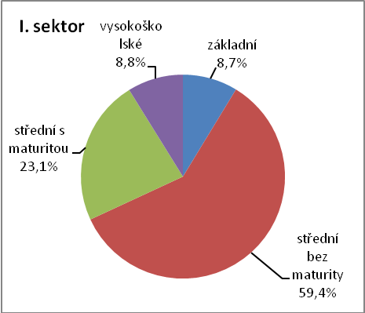
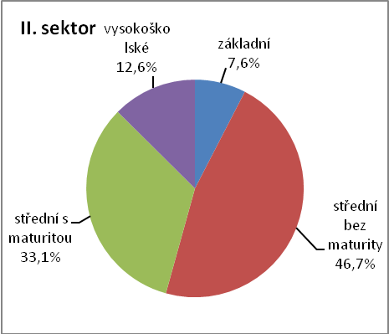
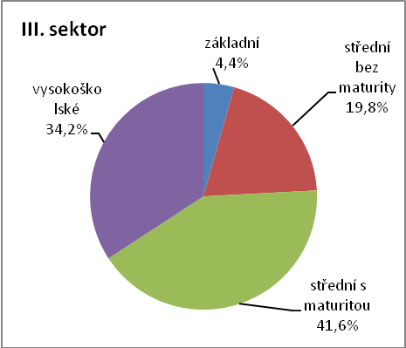
The structure of workers according to education and sectors of national economy

Slide 8
Developement of employment in the region of South Moravia in 2011
Sectors | Number of companies 2011 | 2010 |  | 2011 |  | difference
 |  | totally | % | totally | %
I. sector | 108 | 5 229 | 2,4 | 5 626 | 2,6 | -278
II. sector | 973 | 78 989 | 36 | 82 618 | 38,0 | 2 581
Industry | 779 | 66 302 | 30,3 | 73 260 | 33,7 | 2 861
Construction industry | 194 | 12 687 | 5,8 | 9 358 | 4,3 | -280
III. sector | 1 793 | 134 478 | 61,5 | 128 910 | 59,4 | -461
In total | 2 874 | 218 696 | 100 | 217 154 | 100,0 | 1 842

Slide 9
Employment of foreigners
784 (26,2 %) organizations employed foreigners (decrease by 3,3 of percentage points compared to 2010 )
7 044 foreigners were detected, of which 84,8 % from the EU
According to Ministry of Labour and Social Affairs 29,2 thousand of foreigners were employed in the region (decrease) at the end of 2011 = 4,7 % of the workforce (Czech Rep. 5,4 %)
Brno 8,7 %, Vyškov only 1,7 % of the workforce
The survey covered only 24,1 % foreigners in the region

Slide 10
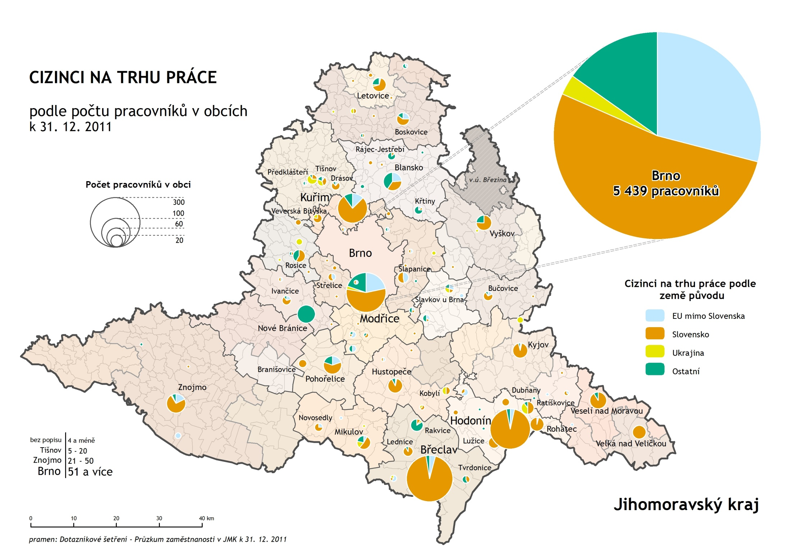

Slide 11
Summary
Unemployment in the region of South Moravia is going to stagnate or decrease slightly in the nearest future
Shift in employment towards the tertiary sphere continues.
Share of foreigners in the labour market in the region will grow again, South Moravian Region (especially the city of Brno) is attractive for foreigners.
The task of economic policy is to oversee that the production newly brought to South Moravian Region meets the qualification level of the local labour force (matching of supply and demand).

Slide 12
‘This project has been funded with support of the European Commission.
This publication [communication] reflects only the views of the author, and the Commission cannot be responsible for any use which may be made of the information contained therein.’

Slide 13
Thank you for your attention!
Labour Office Czech Republic
Regional Branch in Brno

